Slide 1

Car Rental Management
21BCE175 - Shukkan Panchal
21BCE176 - Harsh Pansuriya
21BCE177 - Parishi Shah

Slide 2

Description -
This project is designed to be used by Car Rental Companies who specialise in renting cars to customers. It is a system through which both the company staff and the customers can view the different available cars, their corresponding rents, the total sales on the company side and the final bill on the customer side.
The advancement in technology has greatly enhanced various aspects of business processes and communication between service providers and customers, of which car rental industry is not left out.

Slide 3
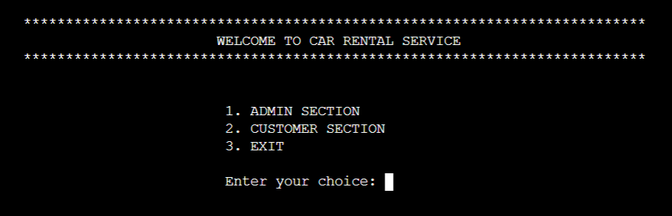
KEY FEATURE OF CAR RENTAL MANAGEMENT SYSTEM:

Slide 4
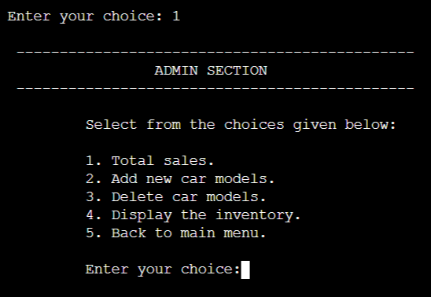
ADMIN SECTION
1.1 Add New Car Models
1.2 Delete Car Models
1.3 View the Inventory
1.4 View Total Sales

Slide 5
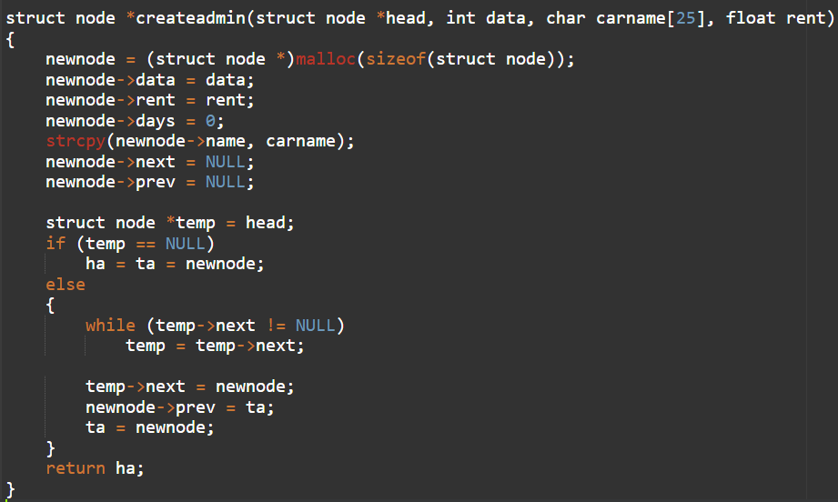
1.1 ADD NEW CAR MODELS
Logic :

Slide 6
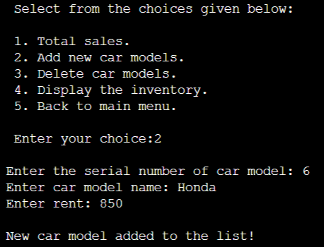
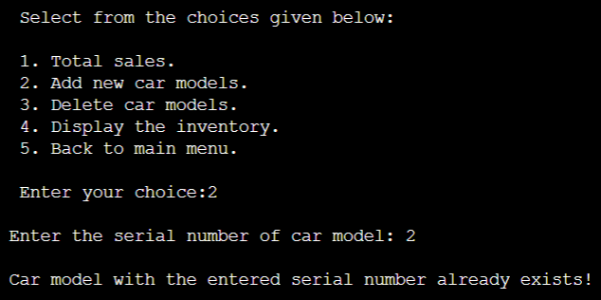
OUTPUT:
Adding a new car to the list:
In case a car with the input serial number already exists :

Slide 7
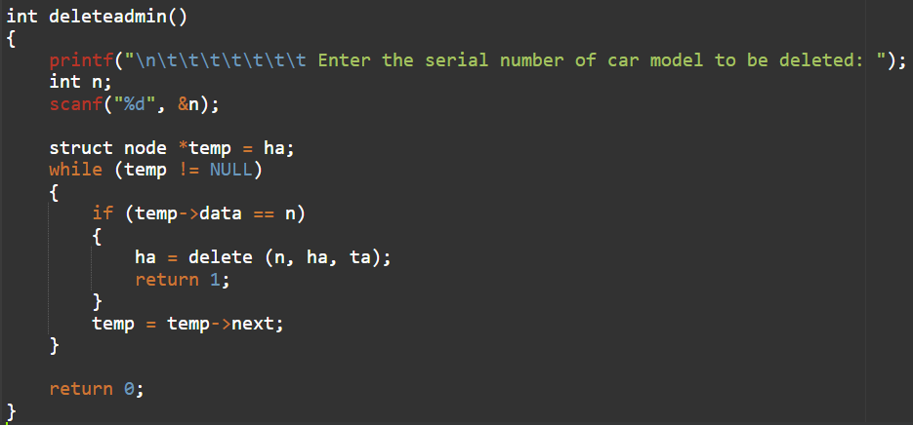
1.2 Deleting Cars from the List
Logic :

Slide 8
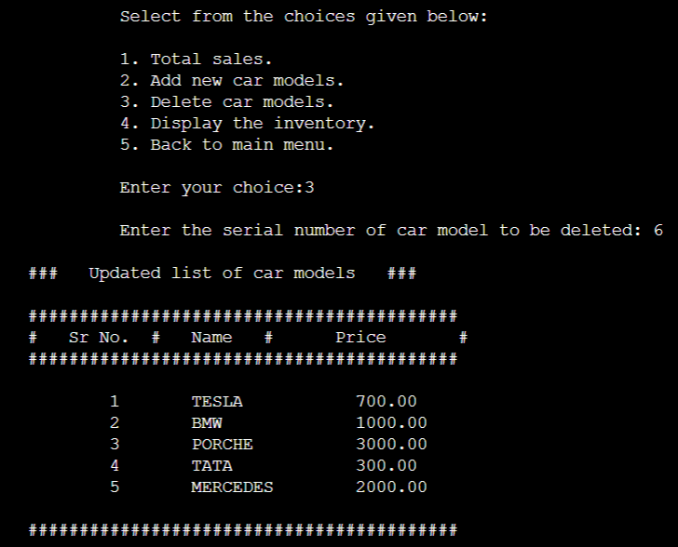
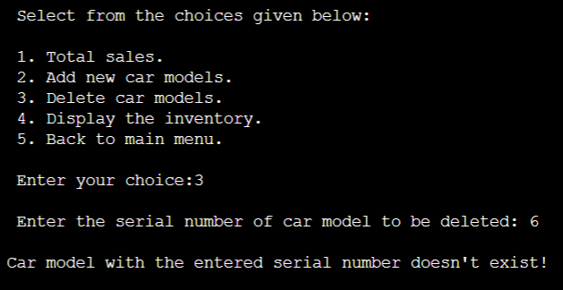
OUTPUT:
Deleting an existing Car from the Rental List:
In case the entered Car is not in the List:

Slide 9
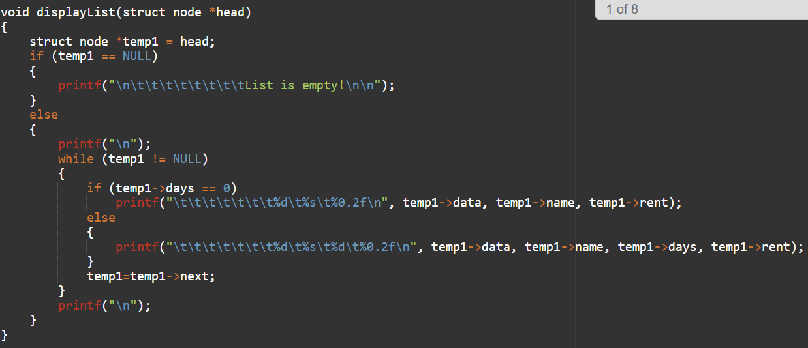
1.3 View the Inventory
Logic :

Slide 10
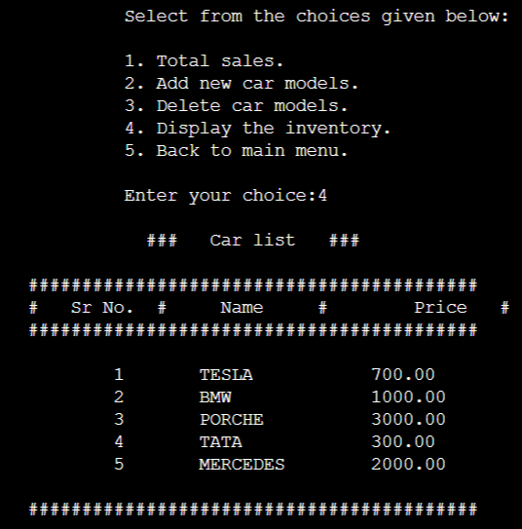
OUTPUT :

Slide 11
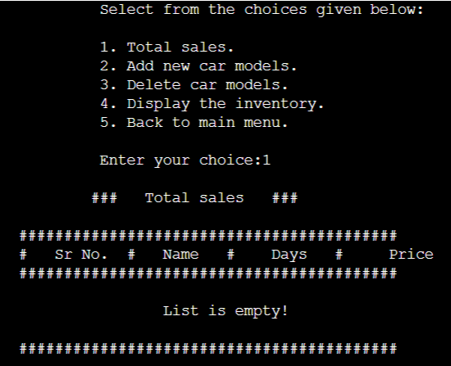
1.4 View Total Sales
At first, when no customer has reserved any Car :

Slide 12
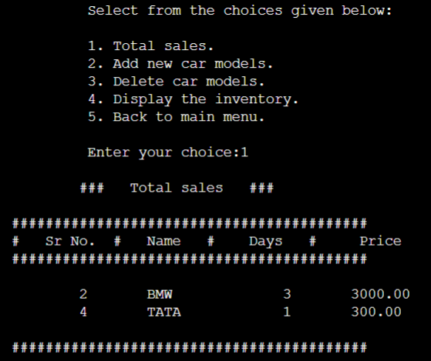
After customers have rented Cars :

Slide 13
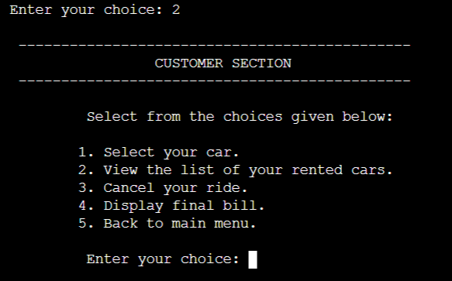
2. CUSTOMER SECTION
2.1 Select Car to Rent
2.2 View the Selected Car(s)
2.3 Delete reservation of a Car
2.4 Final Bill

Slide 14
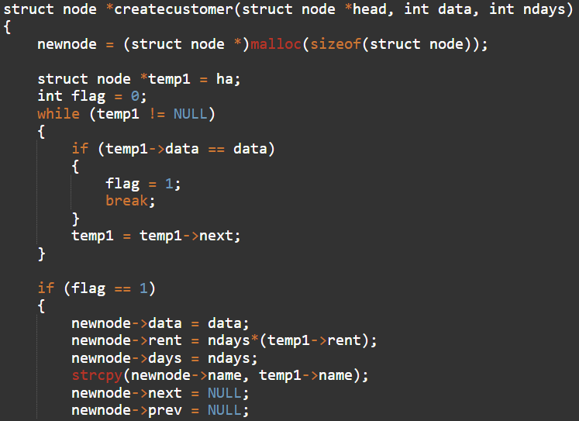
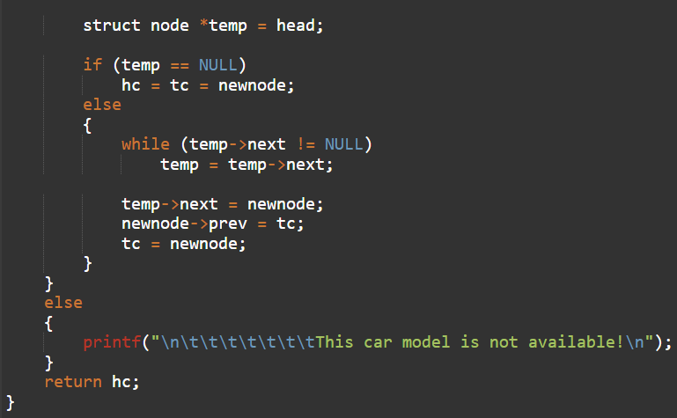
2.1 Selecting a Car
Logic :

Slide 15
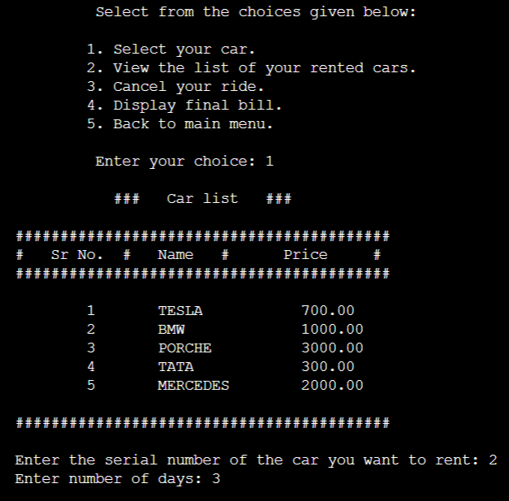
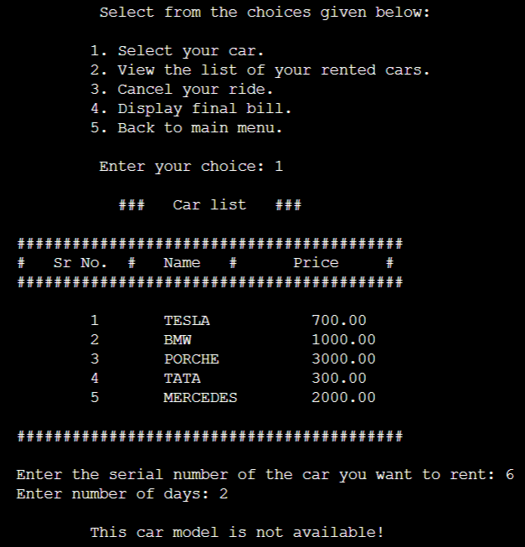
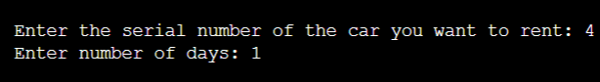
OUTPUT :

Slide 16
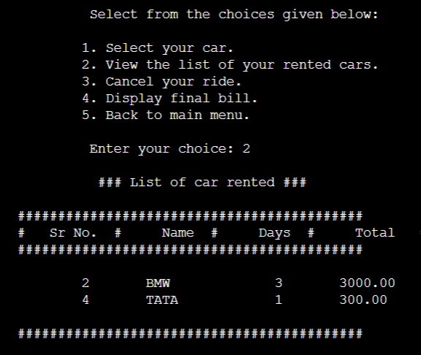
2.2 View the Selected Car(s)
Output according to the previous inputs :

Slide 17
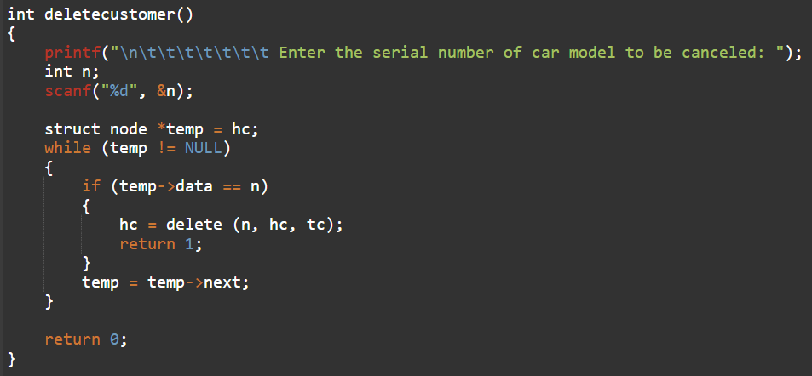
2.3 Deleting a Car Reservation Logic :

Slide 18
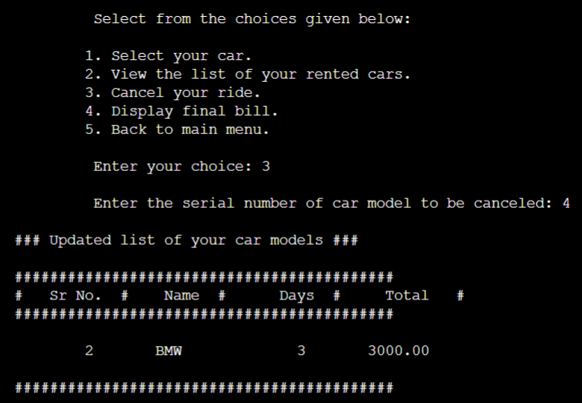
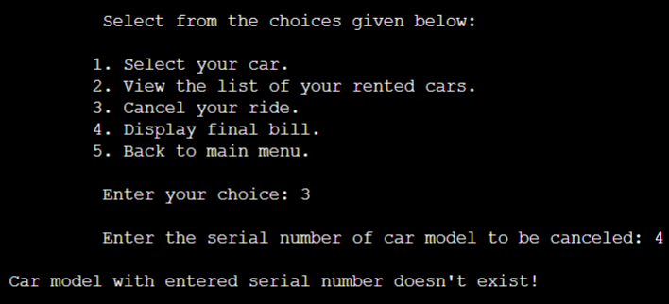
OUTPUT :

Slide 19
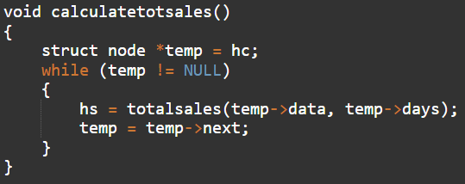
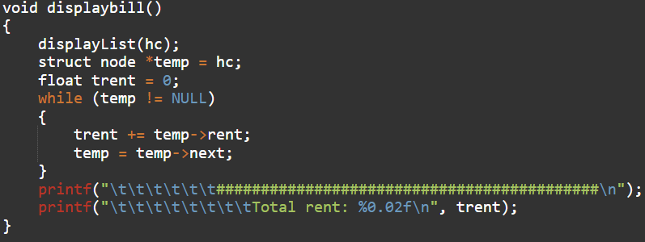
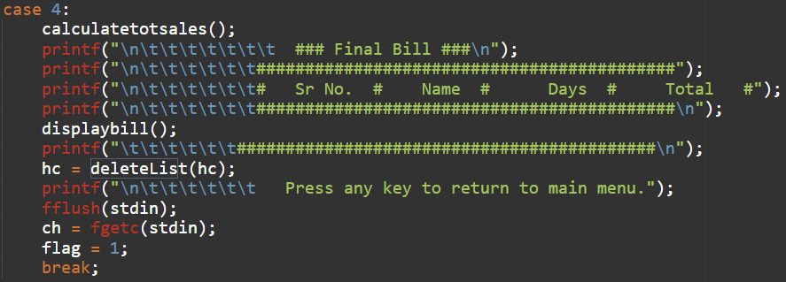
2.4 Final Bill Logic :

Slide 20
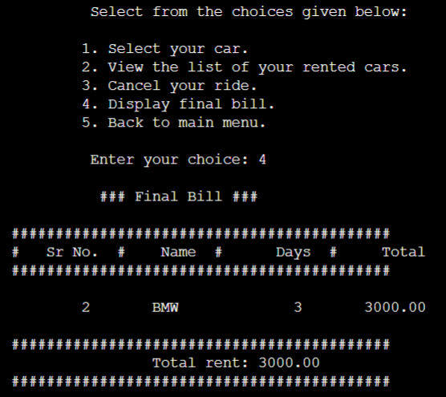
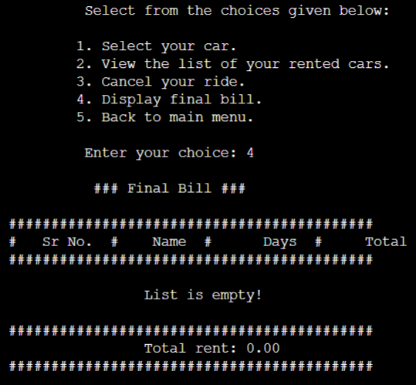
OUTPUT :
If no Car is selected by the customer :

Slide 21
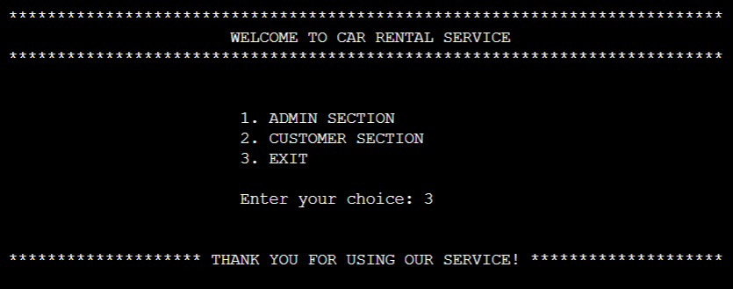
3. EXITING OUR SYSTEM :

Slide 22
Data Structure used and Time complexity
In this program we have used Linked list.In this code the data structure we have used is linked list, linked list is a dynamic type of data structure i.e data elements are not stored in contiguous memory locations. The data elements are called nodes. Each node contains a data field which stores the data and a reference field which contains the address of next node.
Let the length of the linked list be n, then for a particular choice of the user the worst case time complexity will be O(n) because of linear search or traversing through the linked list.

